Slide 1
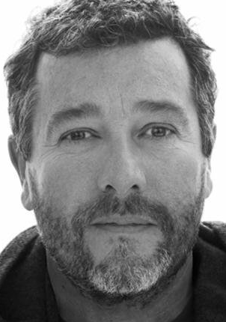






Who was I ?
Who am I ?
1 year ago
Today for Tomorrow
What changed my life ?
Worked in :
CATERING
CONSTRUCTION INDUSTRY
Certificate :
CAP => LOW SALARY
Motivation :
DECLINING
Emotional state :
LOST
Skills and Qualities Assessment:
Work with :
I.T LANGUAGES
(Javascript is my favorite)
My daily life :
DISCOVERY, TRY, FAIL,
LEARN, RETRY,SUCCEED
Motivation :
REGAIN
Emotional state :
SERENE
CREATIVE
CURIOUS
MATHEMATICAL
SERIOUS
(but not to much)
LAZY
(a little bit)
GEEKY

